Slide 1
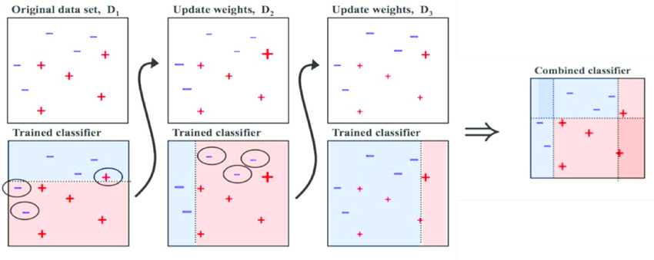
Adaboost is a supervised machine learning algorithm This algorithm
can solve both kinds of problem statements that is classification and regression.It comes under the category of boosting ensemble technique. The basic idea of this algorithm is to collect some weak machine learning algorithms and train them in a sequential order where each weak learner passes some kind of helpful information to the next weak learner so that the next weak learner can learn better.

Slide 2
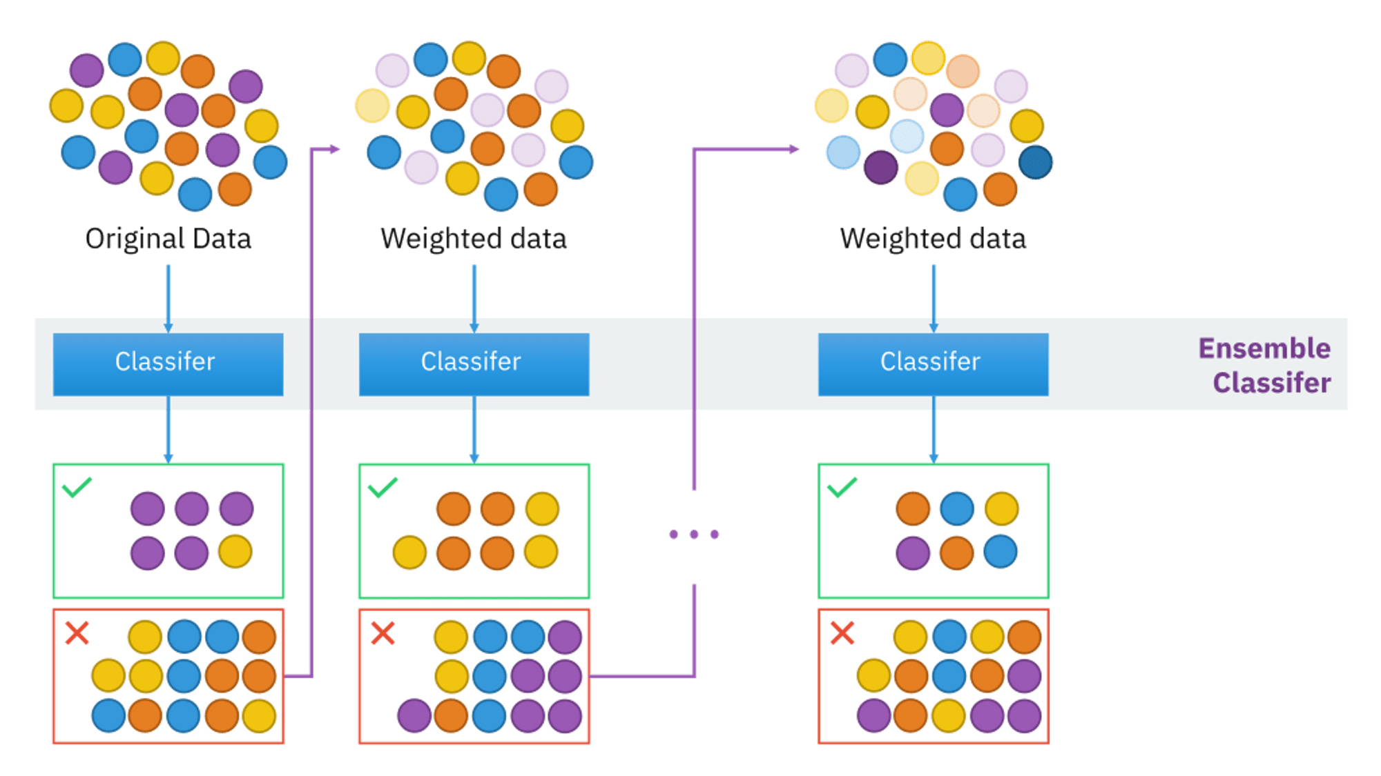
AdaBoost in machine learning is one of these predictive modelling techniques. AdaBoost, also known as Adaptive Boosting,
is a Machine Learning approach that is utilised as an Ensemble Method. AdaBoost's most commonly used estimator is decision trees with one level, which is decision trees with just one split.

Slide 3
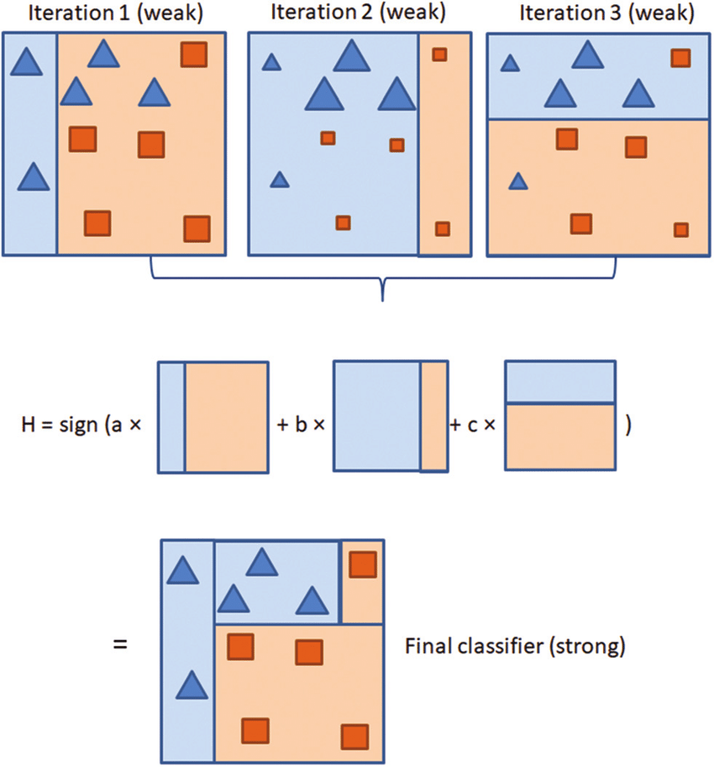
A schematic of the AdaBoost process. Blue triangles and orange squares represent features, with the size of the features representing weighting. Iteration 1,
all features carry equal weight. Iteration 2, correctly classified all features carry equal weight. Iteration 2, correctly classified features (in iteration 1) down-weighted, incorrectly classified feature up-weighted. Iteration 3, correctly classified

Slide 4
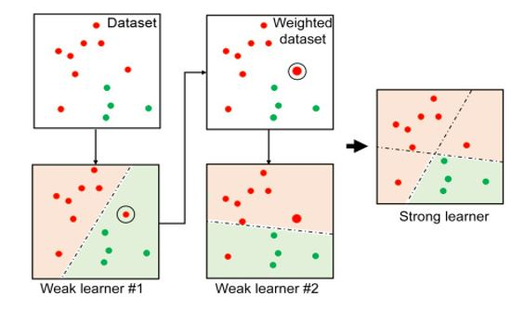
Advantages It is less prone to overfitting Less parameters tweaking Helps in reducing bias and variance
Disadvantages
Accuracy of weak classifiers a can be improved using this method Easy to use
It needs a quality dataset
Very sensitive to outliers and noise
Slower than XGBoost
Hyperparameter optimization is much more difficult

Slide 5
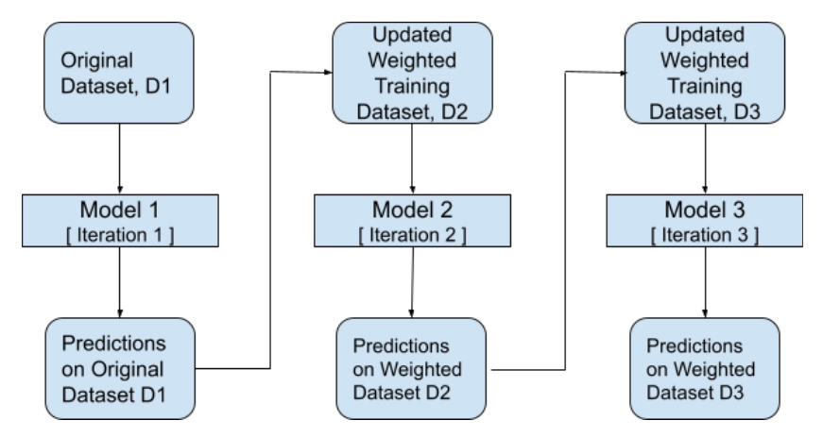
The above diagram shows that Adaboost begins by randomly selecting a training subset. It trains the AdaBoost machine learning model iteratively by picking the training set basedon the previous training's accurate prediction n. gives incorrectly classified observations a larger weight to have a higher chance of being classified in the next iteration. It also allocates weight to the trained classifier in each iteration based on the classifier's accuracy. The more accurate the classifier, the more weight will be given to it.
It
This method is repeated until all of the training data fits perfectly or the maximum number of estimators is reached.
Perform a "vote" across all of the learning algorithms you created to classify them.

